Slide 1
Power Apps Extensions for Power BI/Fabric
Jon Stjernegaard Vöge

Slide 2
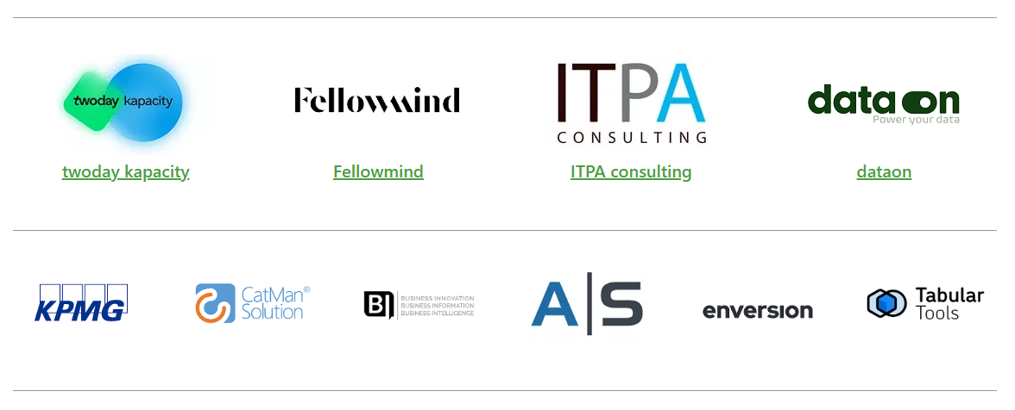
Sponsors

Slide 3





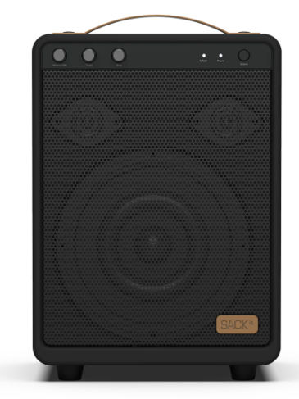

Raffle prizes from the sponsors

Slide 4
Jon Stjernegaard vöge
professional
Senior Consultant at Inspari – a valantic company, driving Power Platform projects and internal community/knowledge center
Education
MSc. Business Administration & E-Business from Copenhagen Business School
Passion
Empowering business users to work better with data, making better decisions, and take matter into their own hands.
personal
27 years old, hobby cyclist, puzzle enthusiast and board game nerd

Slide 5
agenda
FINAL SOLUTION DEMO
Why even bother with Power Apps embedded in Power BI/Fabric?
COMMENT EXTENSION
How to build a Sharepoint/Dataverse/SQL-based comment extension with Power Apps
FABRIC WRITE-BACK EXTENSION
How to build a Power App and Power Automate flow for LIVE data write-back to Fabric
CHAT GPT EXTENSION
How to build a CHAT GPT interface embedded directly in Power BI/Fabric with Power Apps

Slide 6
Extension 1: Comment on data points
Why
Commenting on financial results, trends or other metrics may provide valuable insight. Power BI’s built in commenting is lackluster.
What
A Power App which understands the filter context from Power BI, can write comments to Dataverse/Sharepoint, to be visualized in the Power App itself.
How
Demo time.

Slide 7
Key takeaways: Comment App
PowerBIIntegration.Data is king (transfer data + context)
Can be live and still free! (If using Sharepoint, and data doesn’t need to become part of the Power bI data model)
Be mindful of security if using Sharepoint

Slide 8
Extension 2: Write-Back to fabric
Why
End users often input data through Excel, resulting in poor data quality, and slow time-to-analysis.
What
A Power App allows for governed data entry/editing directly in a data warehouse. Embedding in Power BI allows for better context during entry.
How
Demo time.

Slide 9
Key takeaways: Write-Back app
Write-Back data sources are not born equal. If data is needed in/part of data model, SQL and Dataverse options are easier to work with than Fabric… Yet.
Power Automate with Power Apps patches the gaps
PowerBIIntegration.Refresh() is extremely useful for UX purposes and the feeling of changes being “Live”

Slide 10
Extension 3: CHAT GPT Extension for Power BI
Why
End Users may improve their understanding of data and insight by being able to look up relevant definitions and information directly in their reports.
What
A Power App which calls the Chat GPT API can mirror the chat experience known from the browser.
How
Demo time.

Slide 11
Key takeaways: Chat GPT Extension
Build extensions to look up information from external sources based on both User Input and Model data.
Custom Connectors can be daunting, but often there are alternatives.
One more time: This makes data outside the data model accessible to the user. Game changer.

Slide 12
questions

